Slide 1
Uncertainty Quantification of Text Classification in Multi Labels
for Risk Sensitive Systems
CECS 590 Natural language Processing
Instructor - Dr. Benyamin Ahmadnia
Jinha Hwang Rahul Vishwakarma Carol Gudumotu

Slide 2

Agenda
Introduction
Problem Statement
Proposed Method
Novelty and experiment
Results

Slide 3
Introduction

Slide 4
Machine Learning in Medical Domain
Numerous applications → focusing on medical transcript analysis
Utilizing medical transcription data and smoking behavior patterns
→ Assign patients to certain labels based on transcripts
Previous work relied on traditional NLP techniques

Slide 5
Problems with Text Classification
Wrong Predictions / classifications are inevitable owing to the innate problems in natural language
We can measure the performance of a model, but how certain are we about specific predictions?
We don’t know whether the training data set is sufficient and credible
Uncertainty Quantification

Slide 6
Uncertainty Quantification
Classic deep learning algorithms → only returns a point prediction
ML models should incorporate uncertainty information
→ how much confidence in a prediction is essential
Risk Sensitive Systems
Systems that are crucial to be accurate on their predictions
(e.g., medical domain)

Slide 7
Problem Statement

Slide 8
Uncertainty Quantification of Text Classification In Risk Sensitive Systems
Risk sensitive domain : Identifying smoking pattern, medical transcript inference
→ accuracy is not sufficient
Need of Uncertainty Quantification for a reliable decision making

Slide 9
Proposed Method

Slide 10
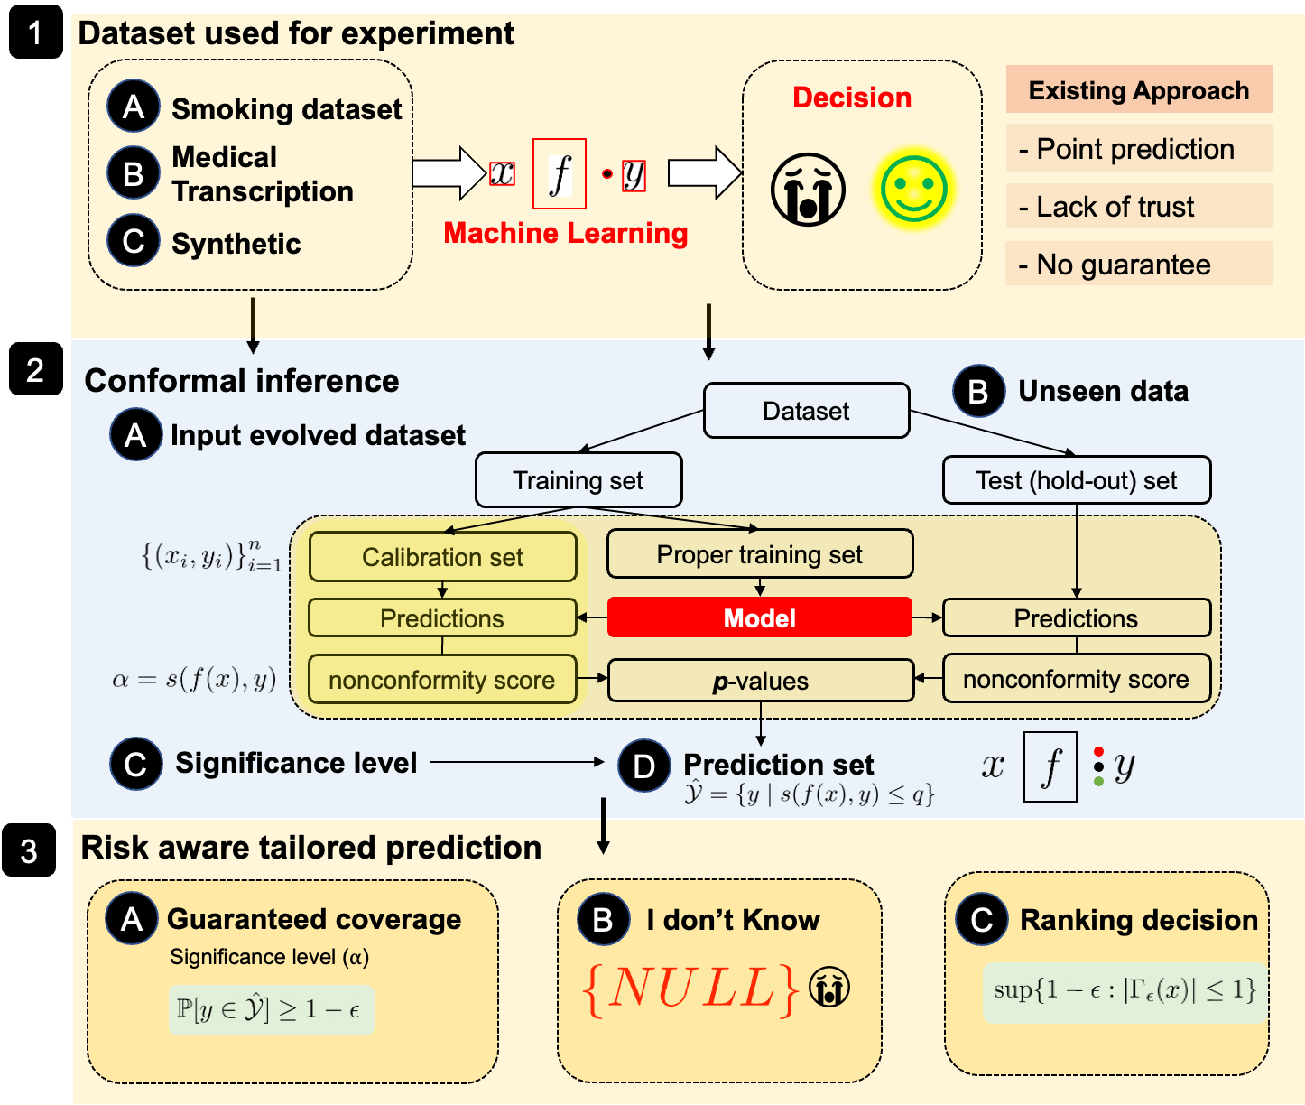
Figure 1: Proposed solution for risk aware decision making for natural language processing classifier

Slide 11
Novelty

Slide 12
Novelty
Incorporates significance level parameter in conformal prediction for guaranteed coverage
Uses rejection option (e.g. Null set) for more trustworthy model
Provides classification labels with confidence and credibility for ranking the decision
a comprehensive and robust approach to text classification

Slide 13
Experimental Framework

Slide 14
Datasets
Index | Dataset Name | Source | Dimensions (Rows X Columns) | Columns | Label (Dependent variable)
1 | Smokers Challenge Dataset | Harvard Medical College | 100 X 2 | Description, Status | Status
2 | Medical Transcription Dataset | Kaggle | 5000 X 5 | description, keywords, transcription, sample_name medical_specialty | medical_specialty

Slide 15
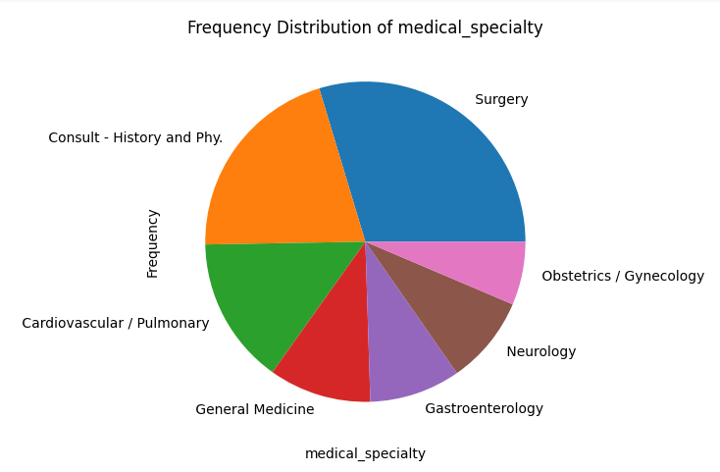
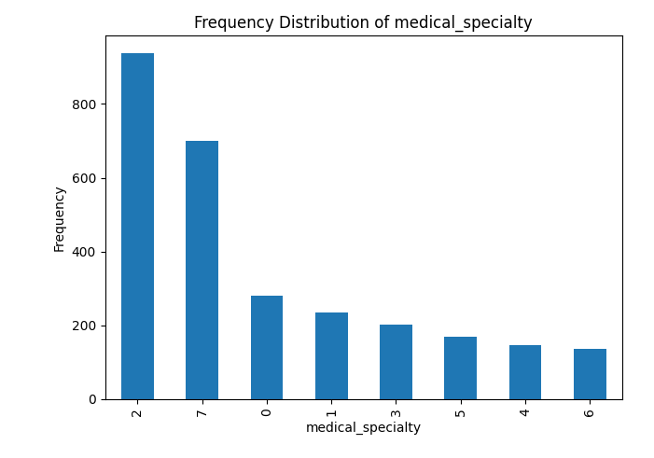
Medical Transcription
Fig: Distribution of the top 7 medical_specialty values/categories
Fig: Distribution of the top 7 medical_specialty
https://www.kaggle.com/datasets/tboyle10/medicaltranscriptions

Slide 16
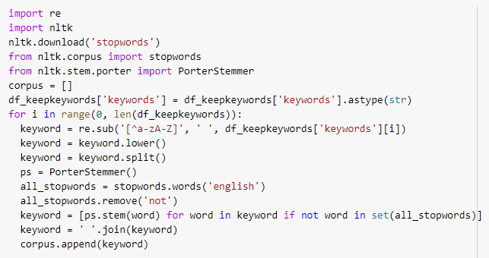
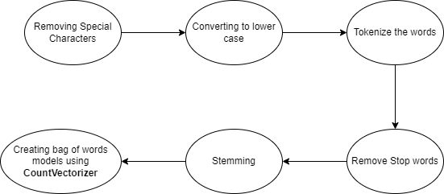

Preprocessing
Preprocessing steps used for cleaning both the datasets

Slide 17
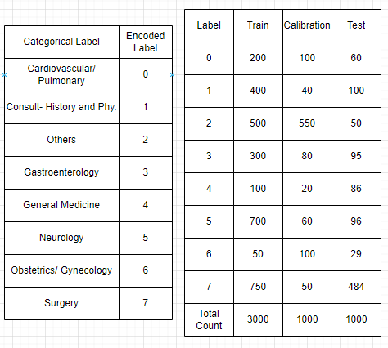
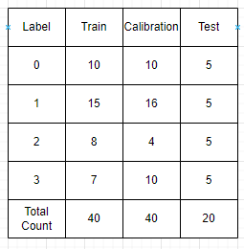
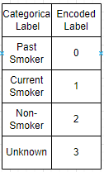
Splitting the Data
Dataset Split for Model Input for Smokers Dataset (40% Training, 40% Calibration and 20% Testing)
Dataset Split for Model Input for Medical Transcription Dataset

Slide 18
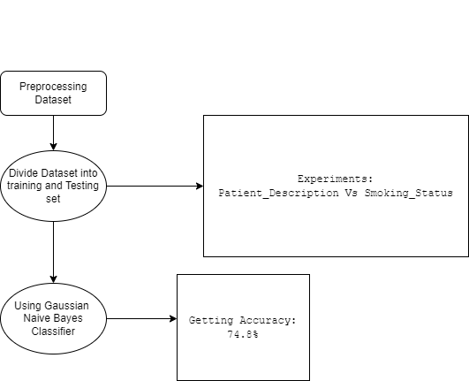
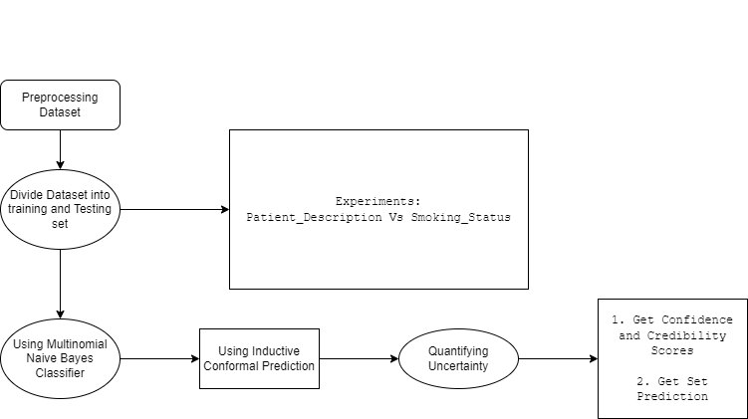
Smoker Dataset
Fig: Experiment without Conformal Predictor
Fig: Experiment with Conformal Predictor

Slide 19
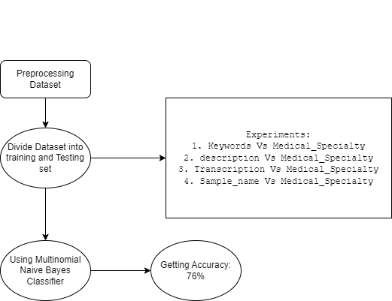
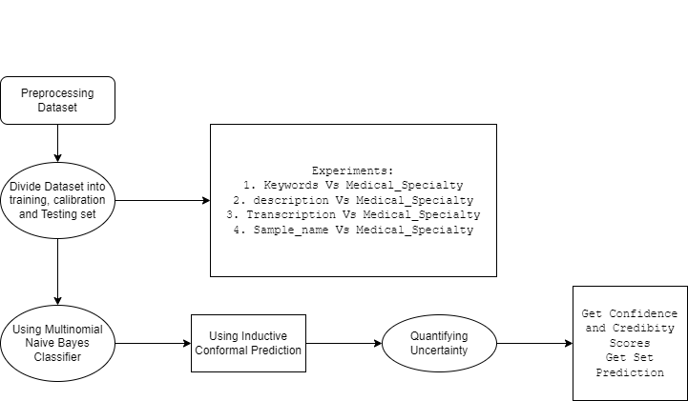
Medical Transcription
Fig: Experiment without Conformal Predictor
Fig: Experiment with Conformal Predictor

Slide 20
Results

Slide 21
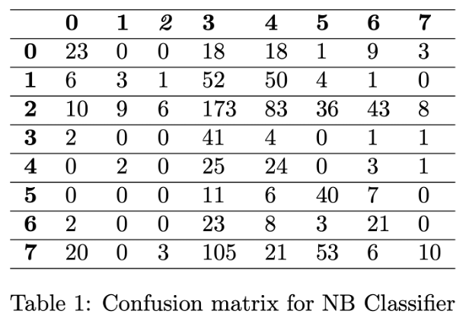
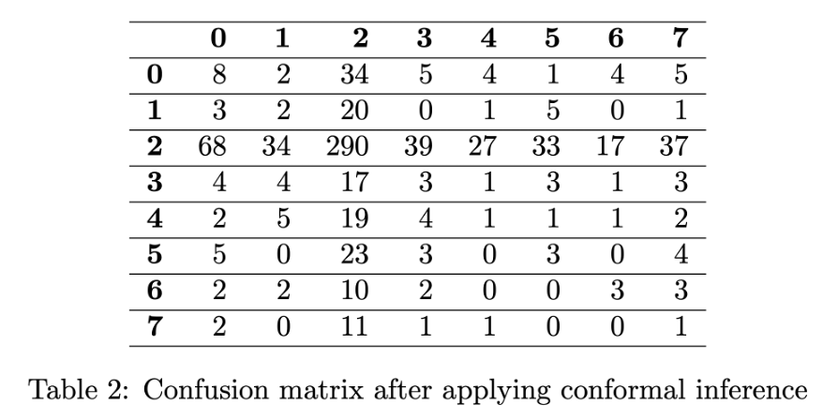

Results on Medical Transcription
Use ANY algorithm
Significance level 0.05

Slide 22
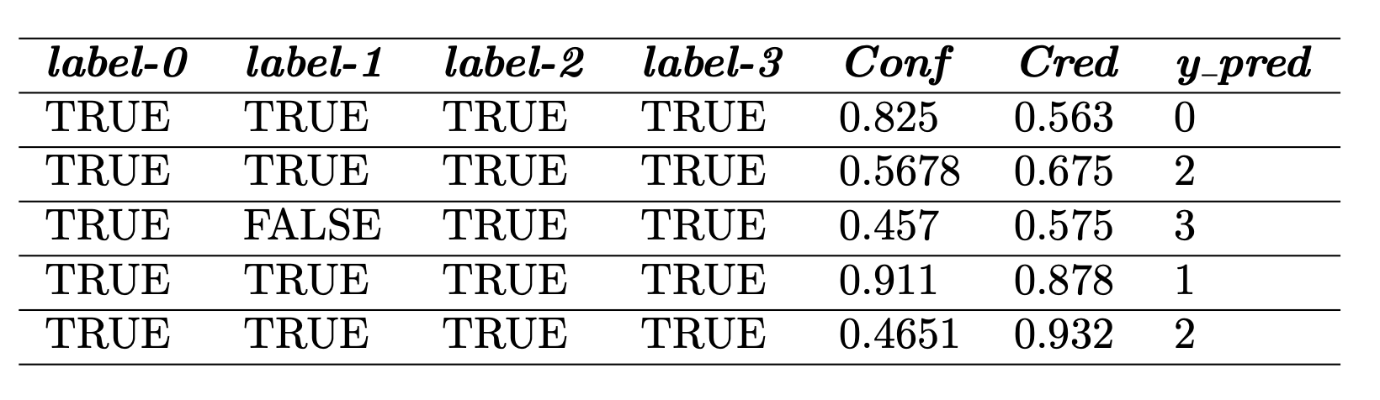

Results on Smoking dataset

Slide 23
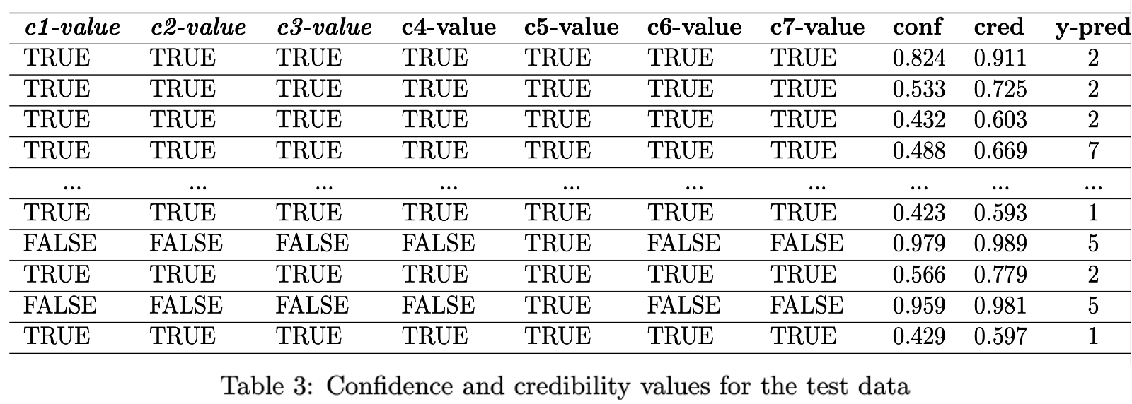
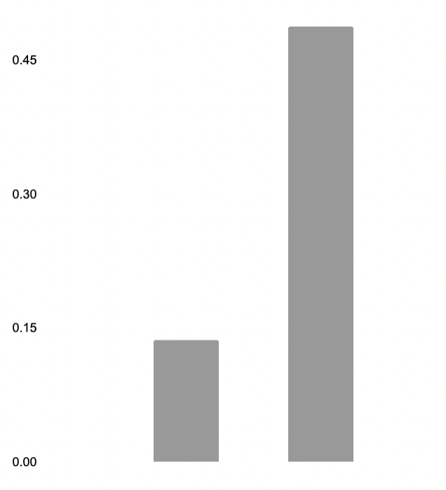
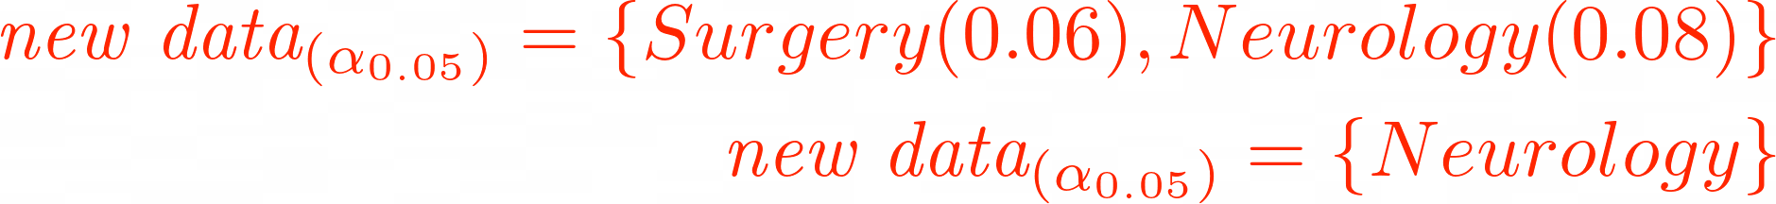
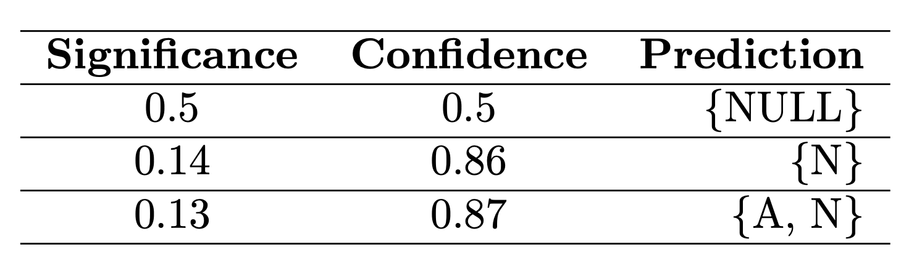
Guaranteed coverage
confidence=0.50
𝑝-value
confidence=0.86
confidence=0.87
I don’t know
𝑝[А] = 0.137
𝑝[N] = 0.488
Algorithm agnostic method for “Reject” option

Slide 24
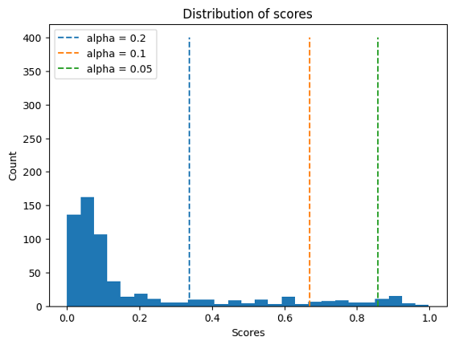
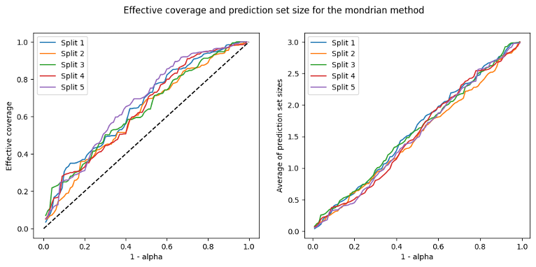
Metrics: coverage; set size

Slide 25
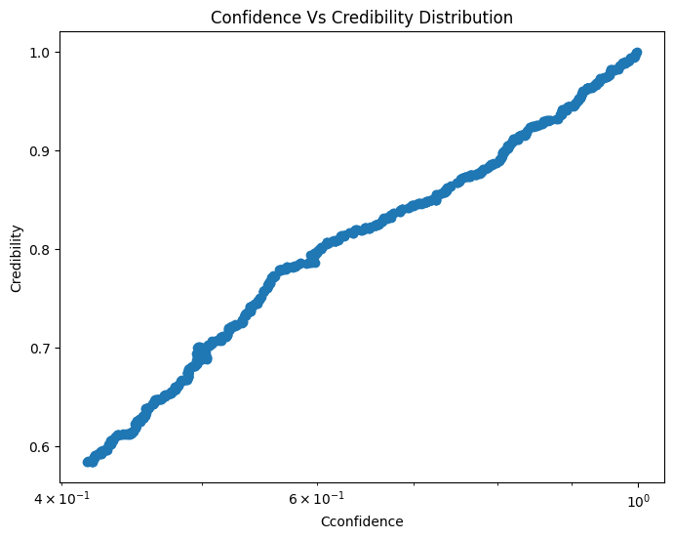
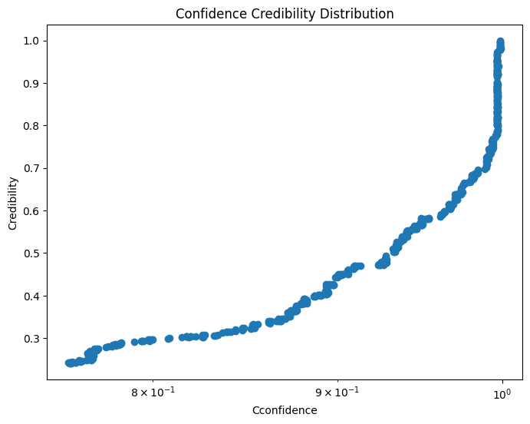
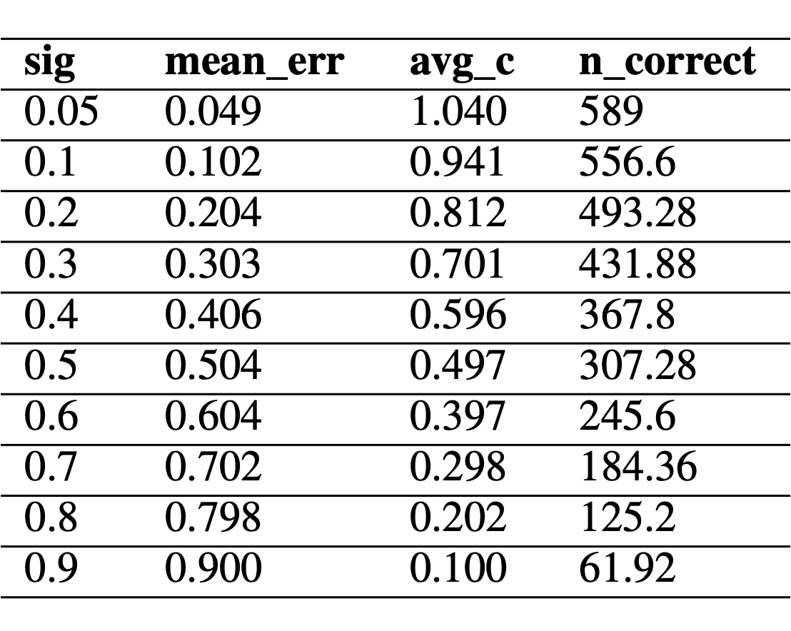
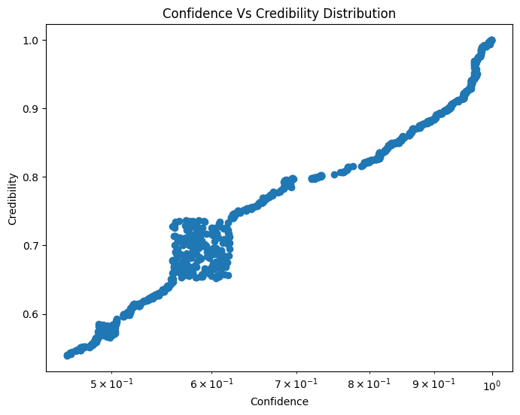
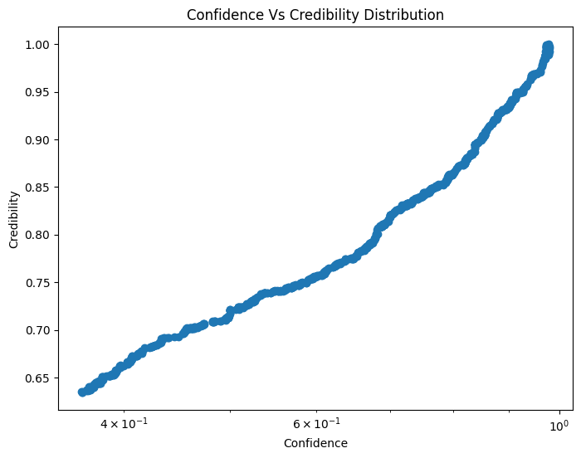
Metrics: conf; cred
Description
Keywords
Sample Names
Transcription

Slide 26
Conclusion

Slide 27
Summary
Three novelty claims:
guaranteed coverage of prediciton
algorithm agnostic risk aware “REJECT”
assign uncertainty associated with prediciton
Designing NCM for kNN and Mondrian classifier with Lesk Score
Validation on synthetic dataset, and medical dataset with multi labels
Evaluation of derived performance metrics (coverage, set size)

Slide 28
References
Mouad Ablad, Bouchra Frikh, and Brahim Ouhbi. Uncertainty quantification in deep learning context: Application to insurance. In 2020 6th IEEE Congress on Information Science and Technology (CiSt), pp. 110–115. IEEE, 2021.
Yusuf Arslan, Kevin Allix, Lisa Veiber, Cedric Lothritz, TegawendÅLe F BissyandÅLe, Jacques Klein, and Anne Goujon. A comparison of pre-trained language models for multi-class text classification in the financial domain. In Companion Proceedings of the Web Conference 2021, pp. 260–268, 2021.
Wenshi Chen, Bowen Zhang, and Mingyu Lu. Uncertainty quantification for multilabel text classification. Wiley Interdisciplinary Reviews: Data Mining and Knowledge Discovery, 10(6):e1384, 2020.
Ronald Cheung, Jacob Chun, Tom Sheidow, Michael Motolko, and Monali S Malvankar-Mehta. Diagnostic accuracy of current machine learning classifiers for age-related macular degeneration: a systematic review and meta-analysis. Eye, 36(5):994–1004, 2022.
Adam D Cobb, Brian Jalaian, Nathaniel D Bastian, and Stephen Russell. Toward safe decision making via uncertainty quantification in machine learning. Systems Engineering and Artificial Intelligence, pp. 379–399, 2021.

